Slide 1
Optimizing MHI

Slide 2
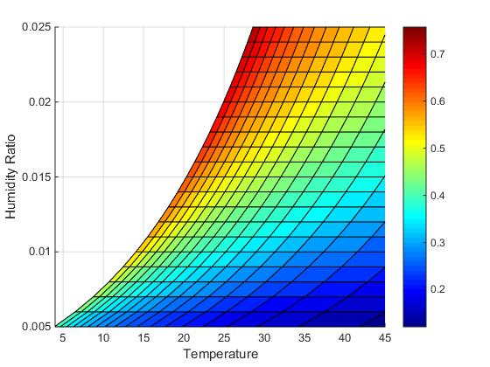
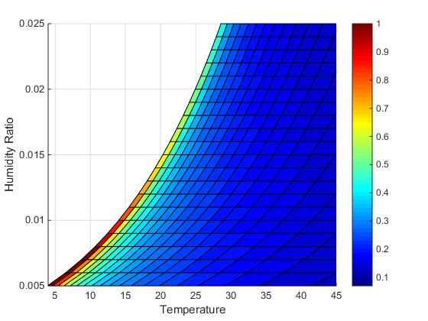
Basic System(No Pre-Cooling)
MHI Mass Flow Rate

Slide 3
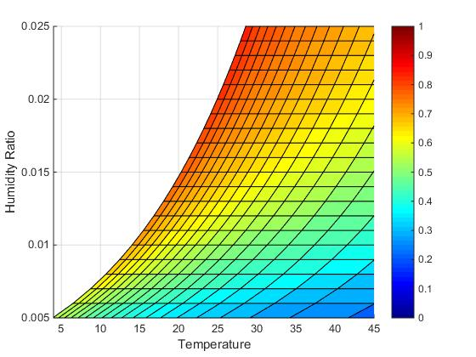
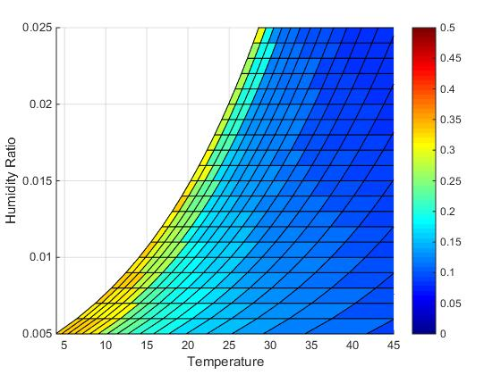
Strategy 1: Pre-cooling with the Help of Heat Exchanger
MHI Mass Flow Rate

Slide 4
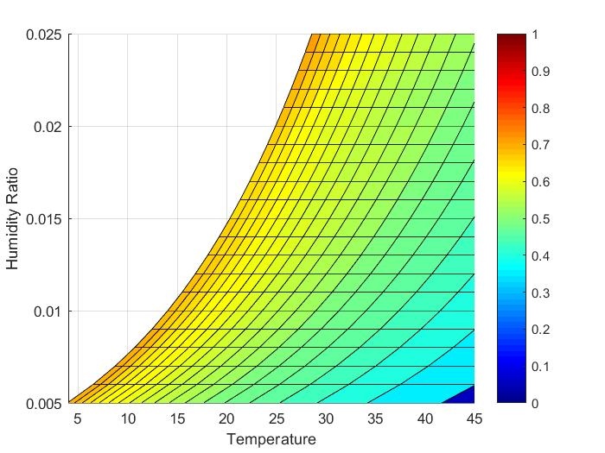
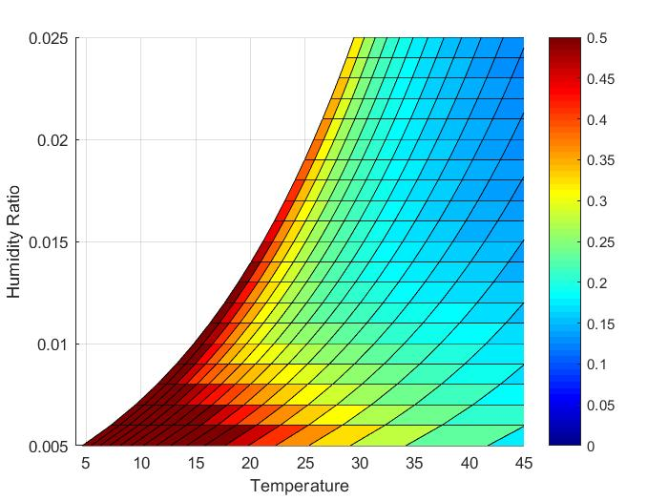
Strategy 2: Maintaining Cold Room
MHI Mass Flow Rate

